Slide 1
Property Price Prediction
Predicting House Prices Using Machine Learning
Alan Cahill
C00174533
Lecturer: Lei Shi

Slide 2
Project Overview
Scrape data from Daft.ie
Classify the properties based upon the relative value of properties in close proximity
Train a machine learning algorithm
Q-Learning
Input details of a property
State the price the property should currently be listed as
Make a prediction of the price of the property in the future
Technologies Used
Python
Beautiful soup 4
Requests
Gmplot
Re
Csv
Sqlite3
Googlemaps
geocoder
SQLite
R
Ggplot2

Slide 3
Progress
Research
Property Price Prediction
Data Science
Machine Learning
Q-Learning
3 Months
Created a Daft.ie spider
Ran the spider weekly
Data Set
Cleaned the Data
Stats and hypothesis testing
Classifier-not 100% completed

Slide 4
Problems
Data science and machine learning
Testing and debugging the spider
Statistics
My stats vs. Example stats
The effect of an area change on the stats
Graph Theory
Too many counties/Town/Areas
Dublin 15
An area in Cork

Slide 5
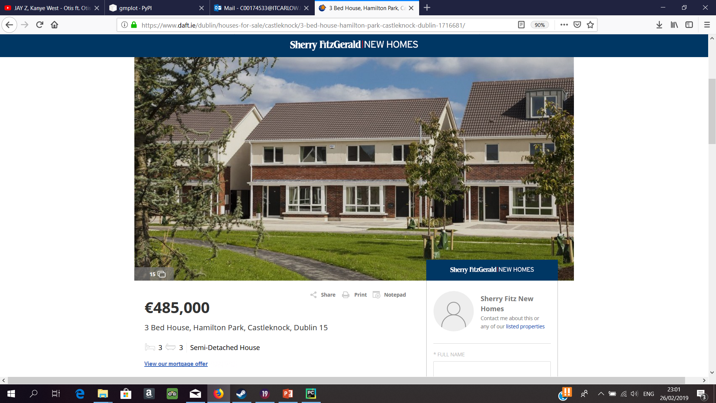

Slide 6


Slide 7


Slide 8


Slide 9
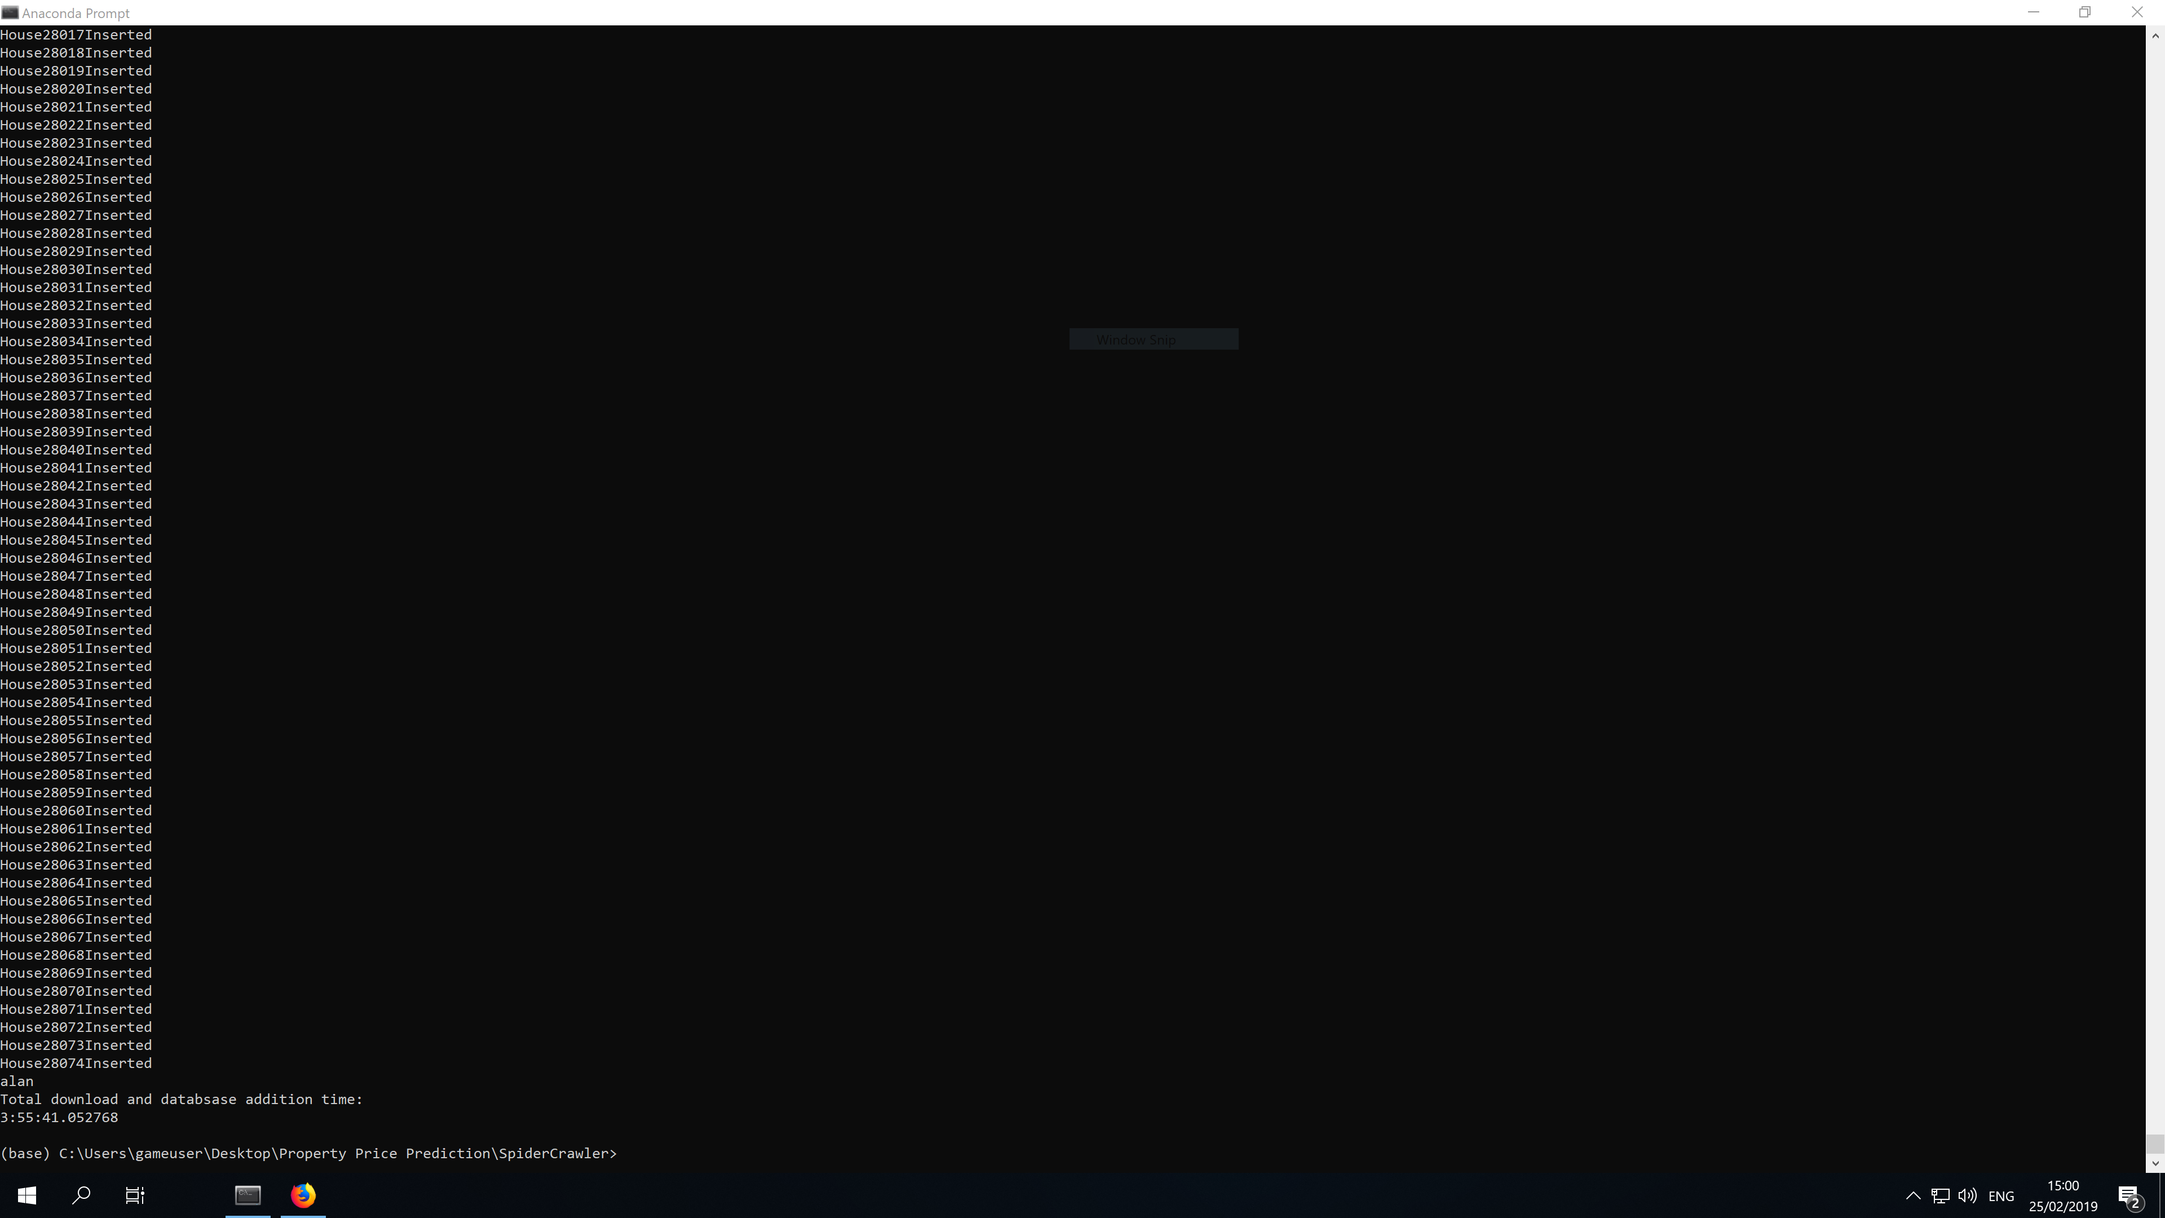

Slide 10
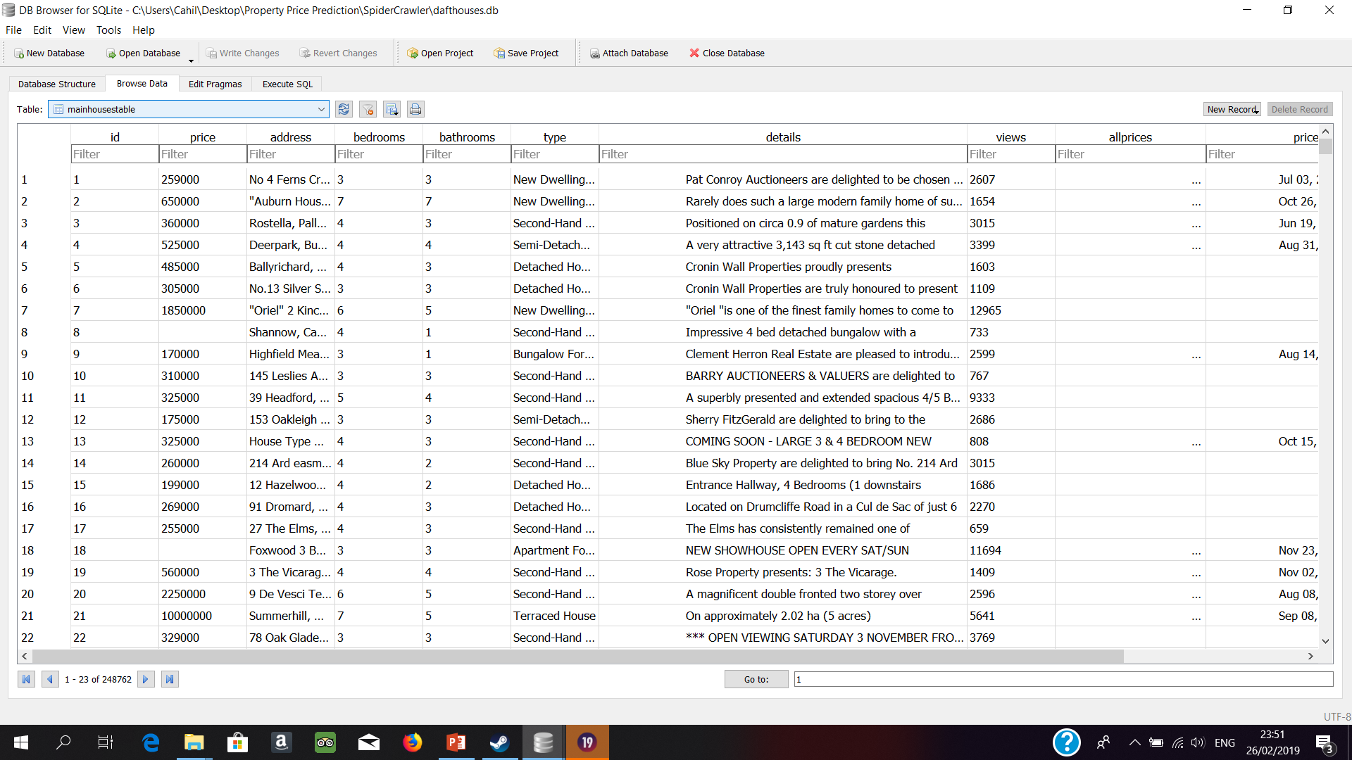

Slide 11
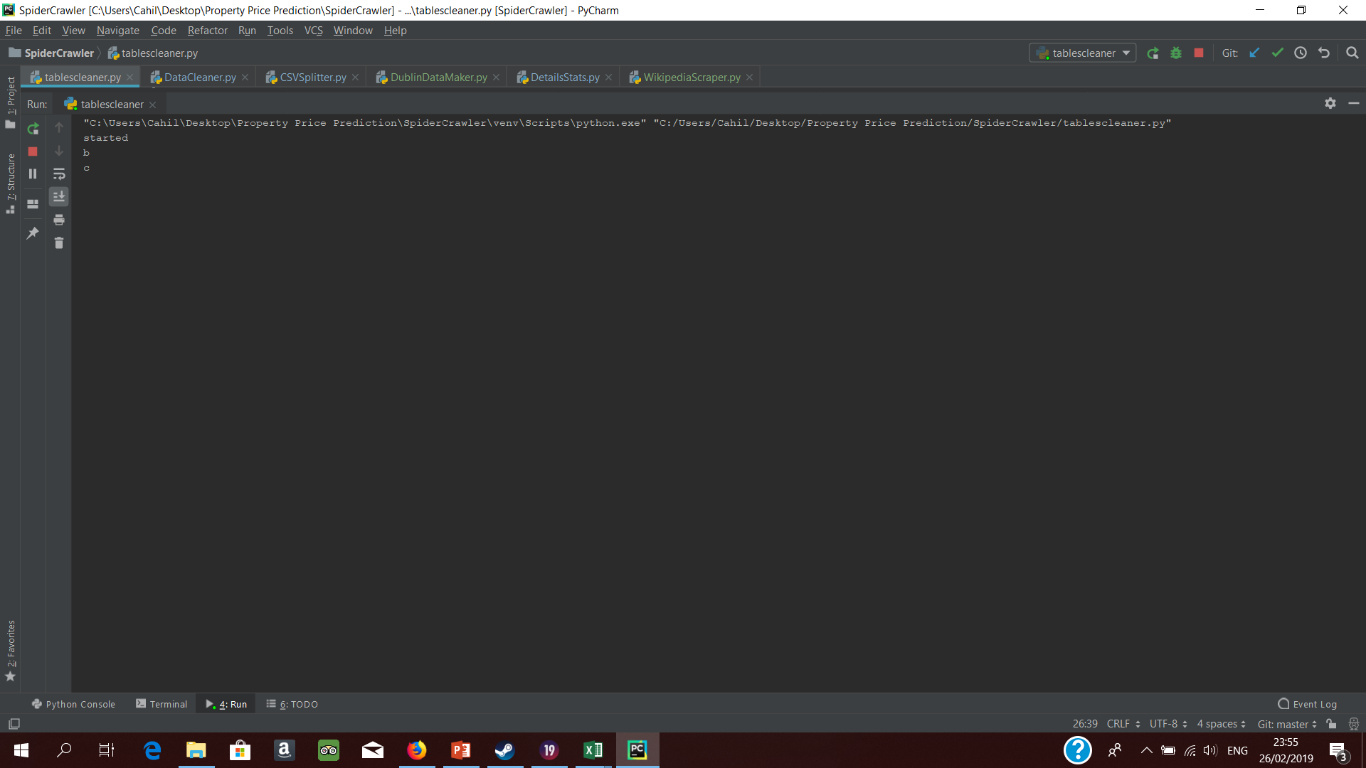

Slide 12
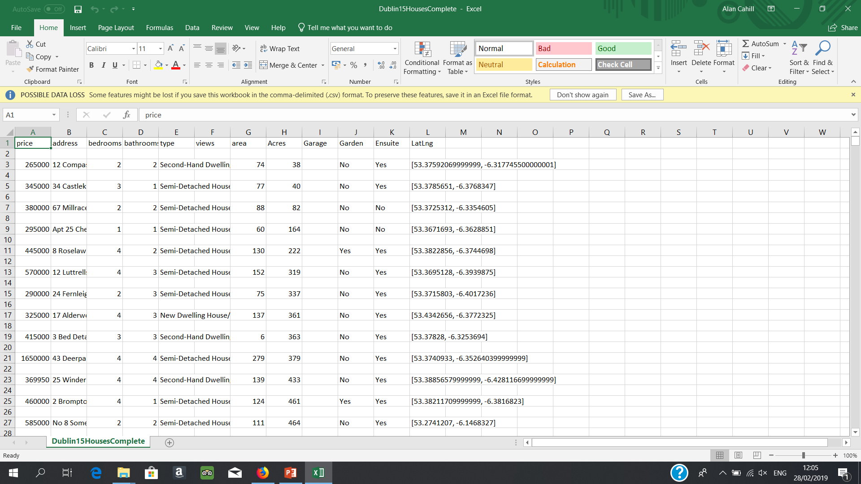
FINAL DUBLIN 15 DATA

Slide 13
Classification Algorithm
A property’s location is the biggest factor on its price
My town as an example (Abbeyleix)
It is not a clustering algorithm

Slide 14
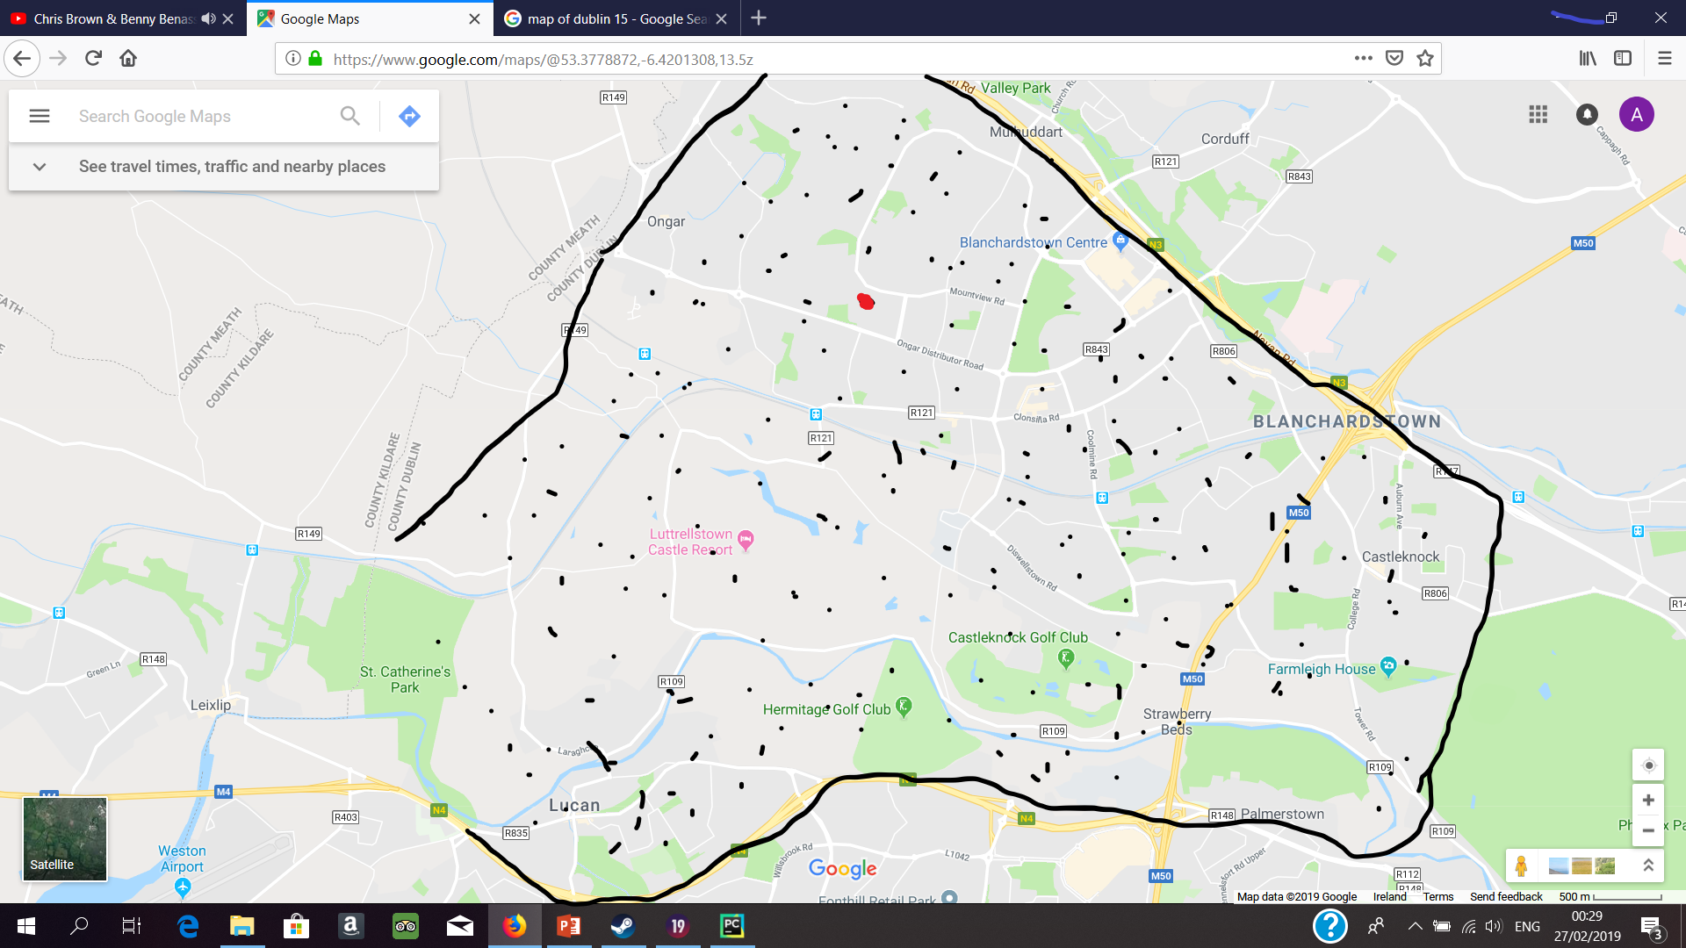

Slide 15
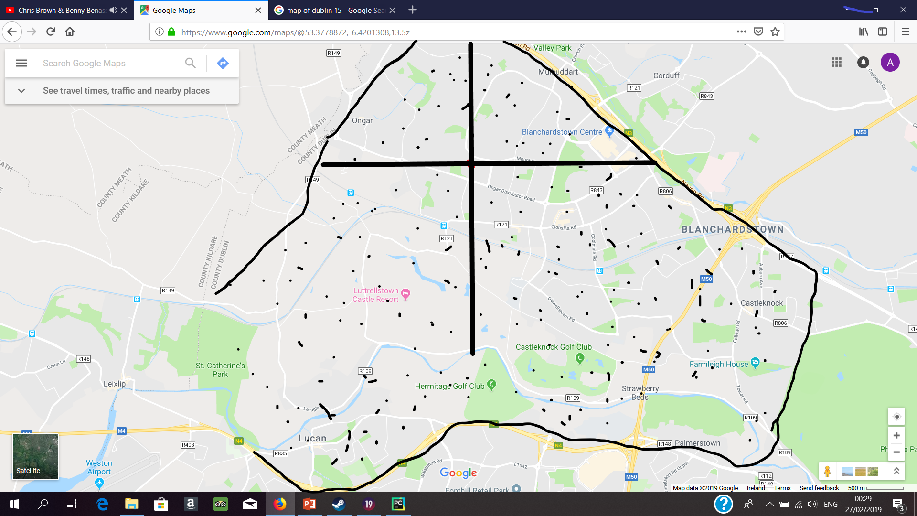

Slide 16
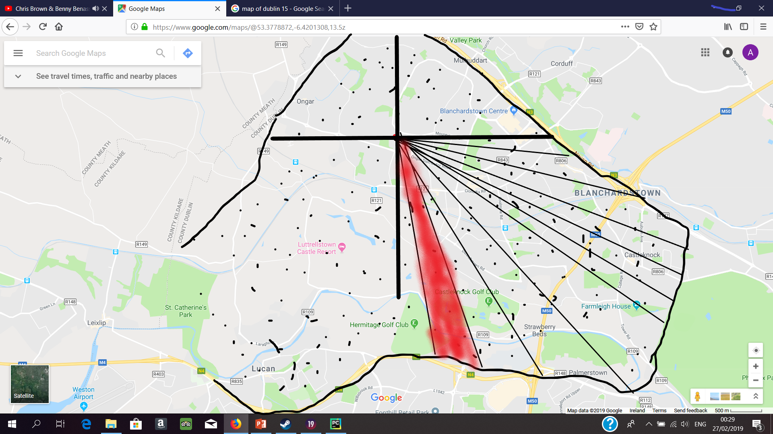

Slide 17
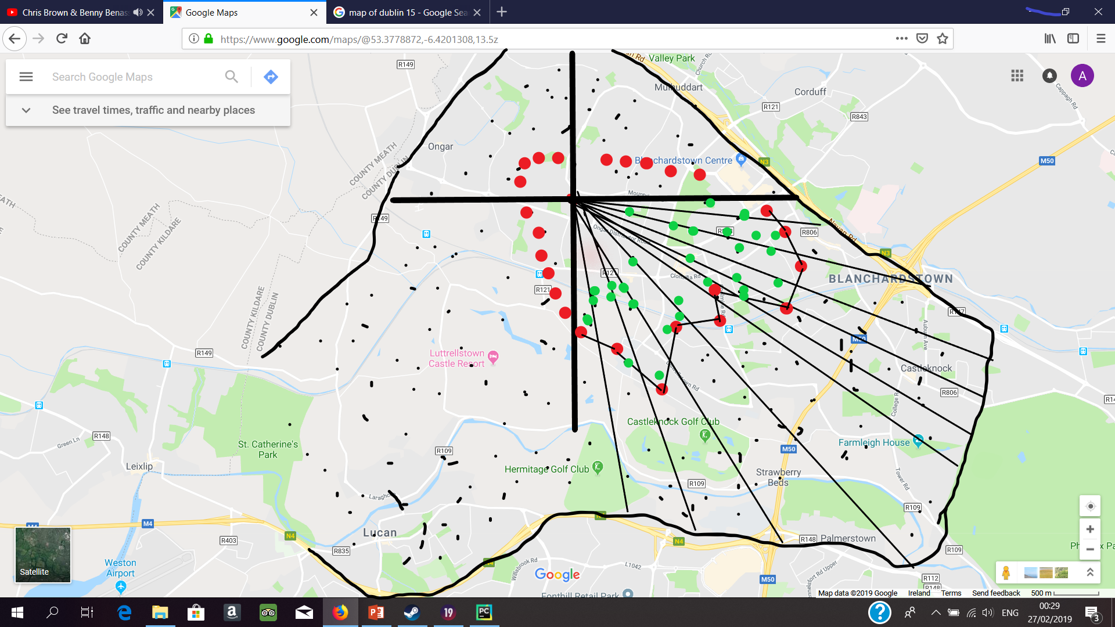

Slide 18
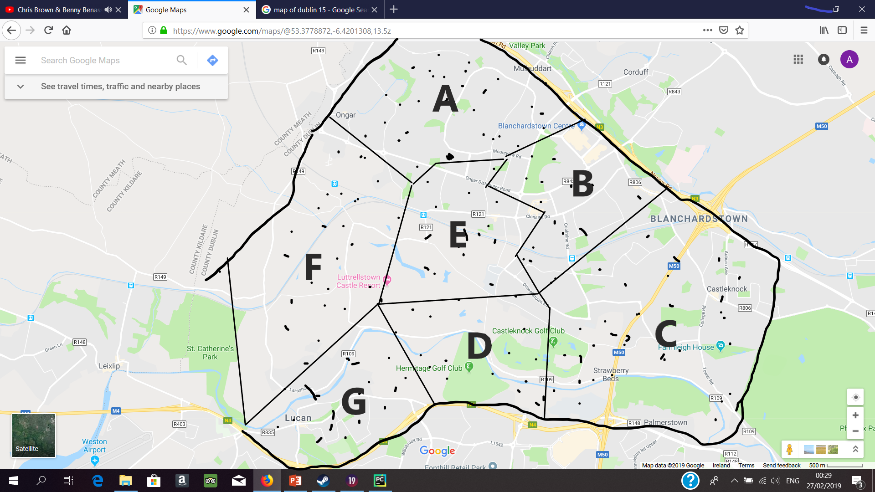

Slide 19
Q-Learning
Model-Free
Partial view of the eniviroment
David Silver
Optimization problem
Very easy calculations involved

Slide 20
Conclusions
A lot of work has been done
The project’s success still hinges on the remaining work
Q-Learning Algorithm
Innovation had already been achieved
Daft.ie spider
More innovation has been achieved again
Classifier
Back-end vs Front-end

